Slide 1
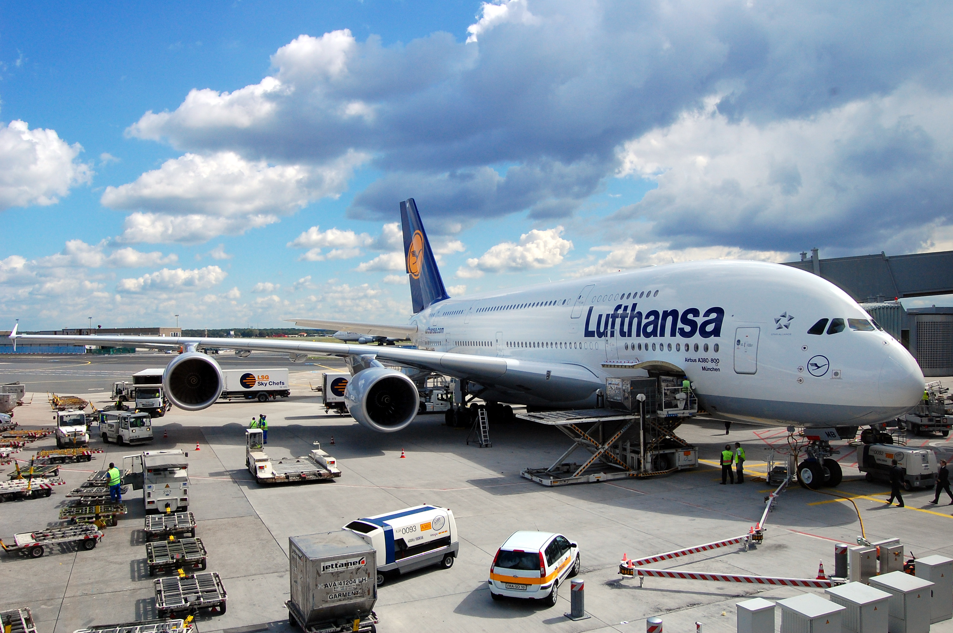
Airline Sentiments
BIBIN LOUIS
This Photo by Unknown Author is licensed under CC BY-

Slide 2
Airline Sentiment Overview
This analysis explores customer sentiment towards major airlines based on social media data.
The data is segmented into positive, neutral, and negative sentiments to identify performance trends.
Key metrics include sentiment distribution, trusted judgments across time zones, retweet impact, and confidence vs. engagement ratios.

Slide 3
Generalization
The sentiment is categorized into negative, neutral, and positive.
United Airlines appears to have a higher number of negative sentiments compared to other airlines, followed by US Airways.
Airlines like Virgin America and Delta have relatively more positive or neutral feedback, indicating possibly better customer satisfaction.

Slide 4
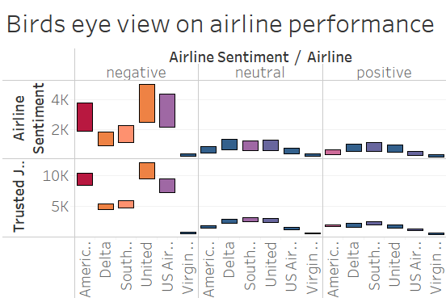


Sentiment Distribution by Airline
United Airlines and US Airways have the highest number of negative sentiments, indicating areas for potential service improvement.
Virgin America and Delta show a balance of positive and neutral sentiments, reflecting higher customer satisfaction.
Fig 1: To identify overall customer sentiment for each airline.
Conclusion: Sentiment data suggests that some airlines may need to address specific service issues to improve customer satisfaction.

Slide 5
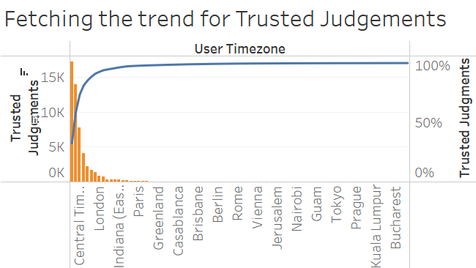

Geographic Distribution of Customer Judgments
A significant volume of trusted judgments comes from Central and Mountain Time zones in the U.S.
The cumulative trend curve indicates that most feedback is concentrated in a few time zones, with the rate of increase slowing down in less populated regions.
Fig 2: To understand where and when customers are most active in providing feedback.
Conclusion: This insight helps airlines focus their engagement efforts in high-activity regions and time zones.

Slide 6
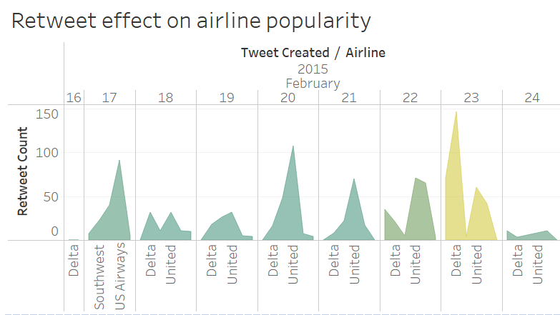

Retweet Impact on Airline Popularity
Objective: To assess the visibility and popularity of airlines on social media through retweet activity.
Delta and United Airlines experience spikes in retweet counts on specific dates, potentially reflecting high engagement during promotions or notable events.
High retweet counts don't necessarily correlate with positive sentiment, as seen with United Airlines.
Fig 3: To assess the visibility and popularity of airlines
on social media through retweet activity.
Conclusion: Retweet activity provides a measure of engagement but needs to be analyzed alongside sentiment for a full picture of brand perception.

Slide 7
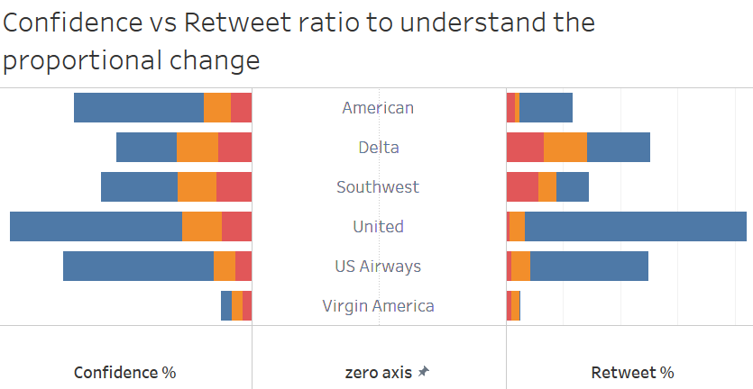
Confidence vs. Retweet Ratio Analysis
United Airlines has high retweet ratios but also has considerable negative sentiment, which indicates strong social media visibility yet polarized customer opinions.
Virgin America has a stable sentiment confidence with lower retweet engagement, suggesting a more consistent customer experience.
Fig 4: To analyze how confidence in sentiment data varies with retweet engagement for each airline.
Conclusion: High engagement does not always mean positive sentiment. Airlines can leverage this data to address customer concerns.

Slide 8
Bird's Eye View on Airline Performance
Negative sentiment dominates for United and US Airways.
Neutral and positive feedback is more balanced across Delta and Virgin America, hinting at better customer service and experience.
Fig 5: To provide a comparative analysis of airline performance across sentiment categories.
Conclusion: Airlines with higher negative sentiments should investigate areas of improvement to match customer expectations.

Slide 9
Recommendations
Recommendations:
Enhance Customer Support: Focus on resolving key issues identified in customer feedback, especially for airlines with high negative sentiments.
Regional Engagement Strategies: Prioritize customer engagement in high-feedback regions to optimize response efforts.
Balanced Social Media Strategy: Use sentiment analysis alongside retweet data to improve online brand image.

Slide 10
Summary
Key Takeaways:
Negative sentiments are higher for specific airlines, suggesting a need for service improvements.
Social media engagement varies widely, with retweets not always indicating positive feedback.
Trusted judgments are concentrated in specific U.S. time zones, highlighting target areas for engagement.

Slide 11
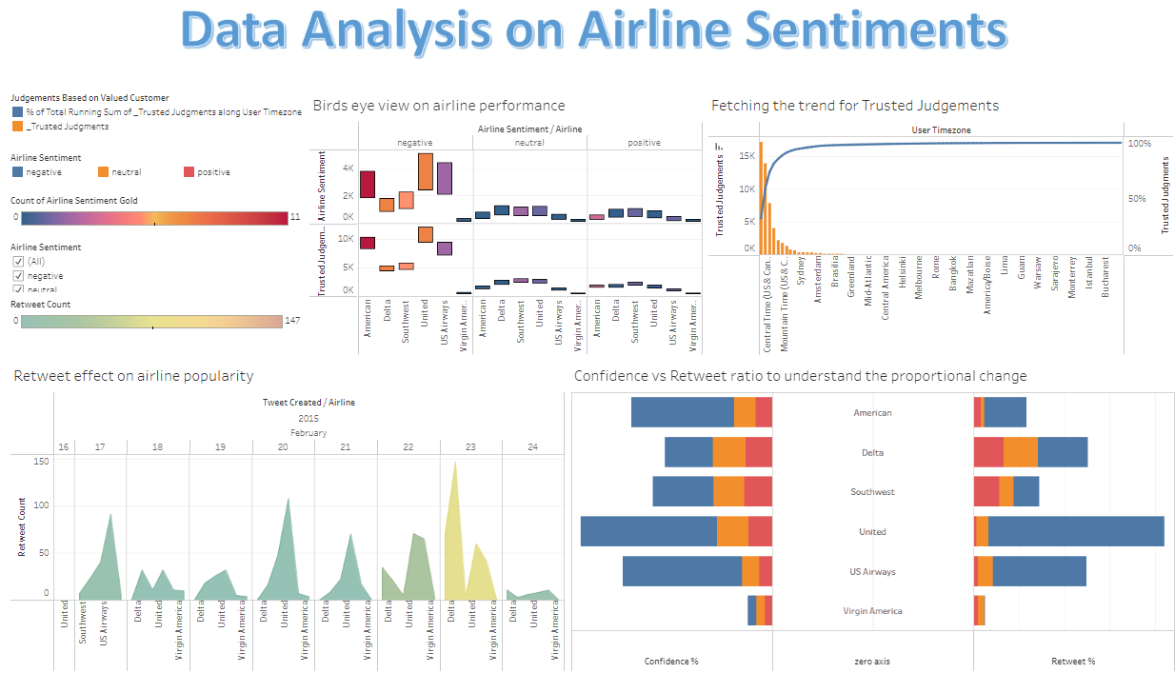

Slide 12

This Photo by Unknown Author is licensed under CC BY-SA

